Slide 1
A Tale of Two Faculties A Study in Contrasts and Lessons Learned
Victoria James, Data Coordinator, Course Evaluations
Gregory Hum, PhD, Assistant Director, Teaching Assessment
Notes:
GH VJ
50 MINUTES

Slide 2
Agenda
Our Institutional and Evaluation Context
Two Contrasting Case Studies, and Defining Success
Key Implementation Lessons
Conclusions
Notes:
GH

Slide 3
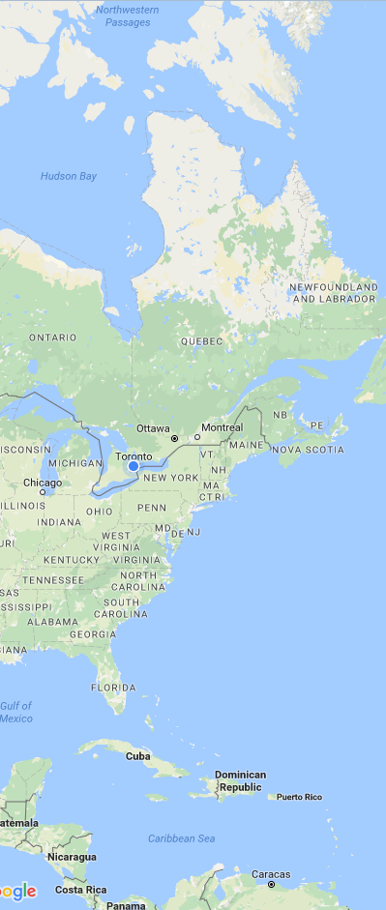
About the University of Toronto
70,728 Undergraduate Students
18,038 Graduate Students
14,240 Faculty Members
3 Campuses, 20 Faculties/Divisions
44 Libraries
https://www.utoronto.ca/about-u-of-t/quick-facts
Notes:
VJ – library 3rd largest system in NA

Slide 4
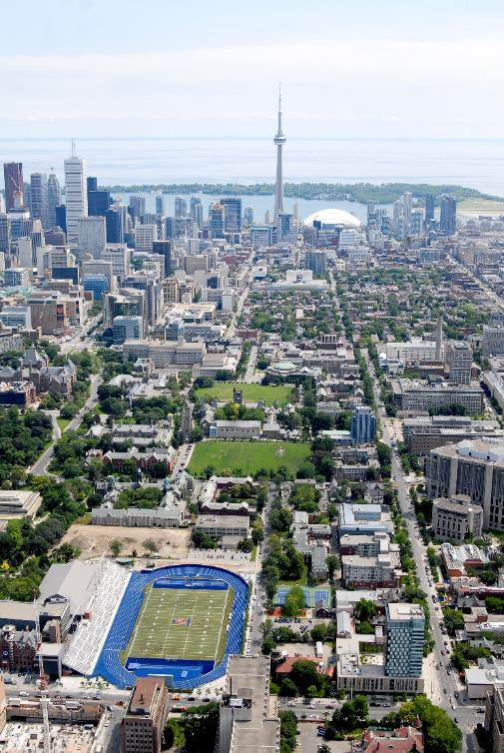
Course Evaluations @ UofT
Began implementing new Course Evaluation Framework with Blue in 2012
11 Faculties served by central Course Evaluations Team
Dedicated, centralized Course Evaluations Team at Centre for Teaching Support & Innovation
Notes:
VJ – more like 16 faculties bc ug and grad

Slide 5
Implementation
Progressive roll-out (projected completion by 2020)
Academically designed and driven framework (EvalUT)
Notes:
GH

Slide 6
The Cascaded Framework
Institution (Core)
Division/Faculty
Department/Unit/ Course
Instructor (Formative)
Centralised and decentralised
Summative and formative
Customized teaching priorities
From broad-based to granular assessment
Notes:
GH

Slide 7
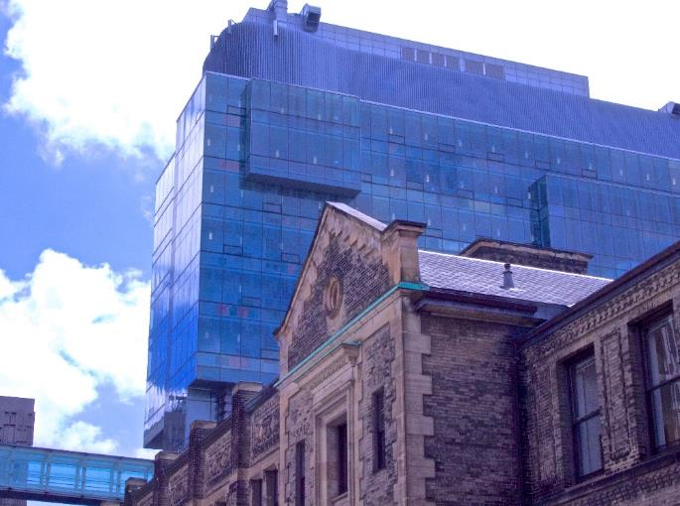
Implementation Overview
Our role: central coordination of stakeholders in bottom-up activities
Local committees
Design priorities
Establish policy
Local ongoing work post-implementation
Point of contact
Local staff prepare ROSI (student information system) data
Local initiatives
Notes:
GH

Slide 8
Compare & Contrast: Case Studies
Large undergraduate faculty with several independent departments
Many classes with variability in class size
Small, professional, graduate faculty
Classes max out with enrolment of 80 students
Faculty A - “Challenging”
Faculty B -“Early Success”
Notes:
VJ

Slide 9
Defining Success
Leaders delegated main responsibilities
Poor “buy-in” by faculty
Procedural issues have lead to problematic data reporting
Mixed success with relationships
Ongoing conversation with leaders
Use of course evaluation data in faculty program review
Helped us identify gaps in our data
Consistently positive relationships
Faculty A - “Challenging”
Faculty B -“Early Success”
Notes:
VJ

Slide 10
Key Lessons
Community consultation and buy-in set the stage
Collaboration and engagement are key
Build and maintain sustainable processes
Notes:
GH

Slide 11
Consultation and Buy-In
Faculty A - “Challenging”
Faculty B -“Early Success”
Decision to implement made quickly, and implementation occurred on a condensed timeline
No defined communication strategy
High skepticism, low confidence in the system
Resistance and preference for prior methods
Discussions regarding implementation lasted over a year, with multiple meetings
Consistent communications
Low skepticism, high confidence
Enthusiasm for new system
Notes:
VJ

Slide 12
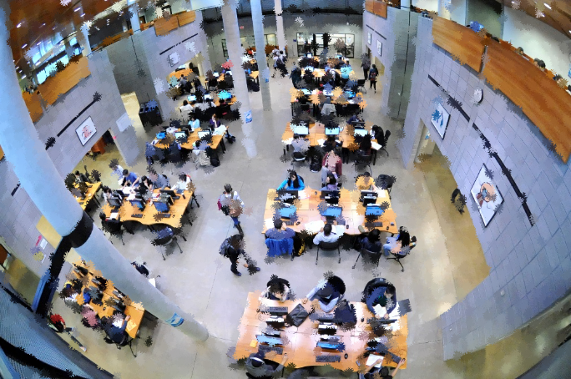
Consultation and Buy-In
Change is a collaborative process bottom-up and top-down
Buy-in is contingent on local contacts/actions
Buy-in & consultation shouldn’t be rushed
Be available to guide and facilitate
Presentations & meetings
“Move towards the resistance”
Notes:
GH

Slide 13
Collaboration and Engagement
Faculty A - “Challenging”
Faculty B -“Early Success”
Course and instructor data were collected with little input from departments
Miscommunications over central online data verification tool
Open communication with instructors
Determined best contacts for day-to-day course evaluations questions
Change of staff meant rebuilding relationships
Notes:
Note in A section – agreed to compromises in hopes of improving engagement
VJ

Slide 14
Collaboration and Engagement
Key contacts are important
Find allies (it’s never too late!)
Remain in and/or re-establish contact (meet/train newcomers)
Communication strategies are essential
Advising students and faculty (pop-ups in LMS, posters, presentations, newsletters)
Keep local and central conversations going to maintain focus and engagement
Use evidence to drive the conversation
Notes:
GH

Slide 15
Sustainable Processes
Faculty A - “Challenging”
Faculty B -“Early Success”
Errors occurred due to previous agreed-to conditions
Course Evaluation Team smaller at time of implementation
Earlier implementation with fewer established processes
Connection with Registrar’s Office, and introduction to online data collection tool early on in the process
Course Evaluation Team had more members
Later implementation with stronger understanding of process
Notes:
VJ

Slide 16
Sustainable Processes
Support local processes
Written resources
Training and education
Develop and sustain long-term sustainable processes
Create and update roadmaps
Match process to available resources
Be cautious with short-term solutions/compromises
Continuously re-evaluate processes
Look at the data
Notes:
GH

Slide 17
Measuring Success
Notes:
VJ

Slide 18
Measuring Success
Notes:
GH

Slide 19
Summary: Key Lessons
Community Consultation and Buy-in Set the Stage
A strong initial foundation is ideal
It is never too late
Collaboration and engagement are key
Find and maintain relationships with those you can count on
Processes/outcomes are inter-connected
Build and maintain sustainable processes
Be explicit
Be flexible – within reason
Keep re-evaluating and learning
Notes:
GH, VJ, GH

Slide 20
Questions?

